Slide 1
Citation Prediction Bioinformatics
Darpan Jhawar // Logan Hornbuckle // Luke Davis // Mouna Kalidindi // Steve Stamey

Slide 2
Exploring our data and it’s relationship with citations
Here’s what we found

Slide 3
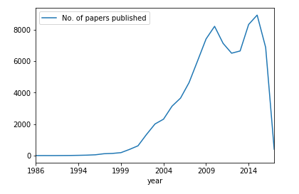
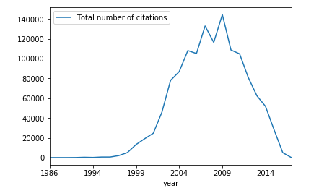
No. of papers v/s no. of citations
Correlation is 0.65

Slide 4
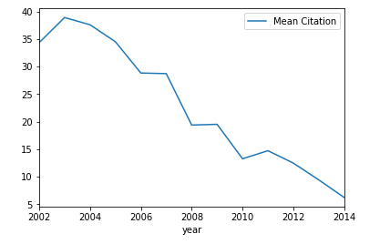
year and citations Proportion
Citation highly correlates to the year the paper is published.
Older the paper higher is the citation rate.

Slide 5
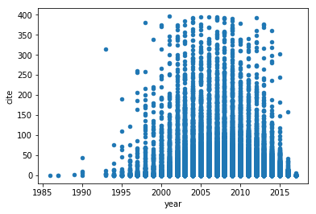
Big Picture View of
Citation Distribution
Scatter-plot of # of citations
across all years
> Removed outliers greater than 3 s.d. <
away from mean
s.d. | 132
3*s.d. | 396
median | 2
‹#›

Slide 6
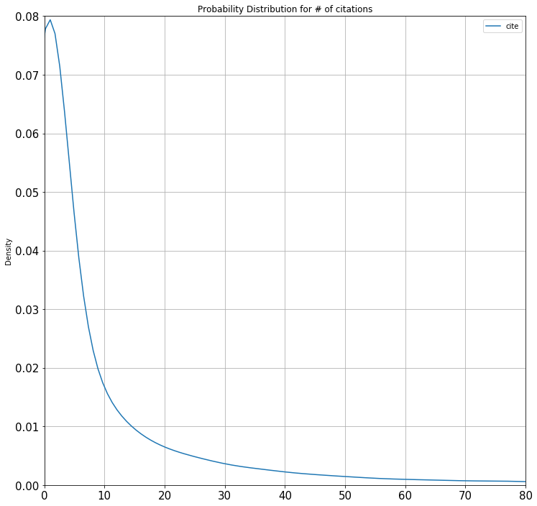
Big Picture View of
Citation Distribution
Probability distribution of # of
citations across all years
> Removed outliers greater than 3 s.d. <
away from mean
s.d. | 132
3*s.d. | 396
median | 2
‹#›

Slide 7
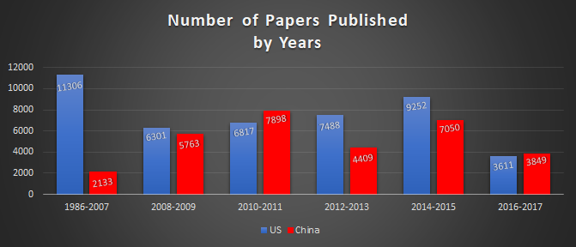
Papers Published by Top 2 Countries

Slide 8
Top 10 Affiliations (highest numbers of papers published)
School | Publication Count | Average No. of Citations
European Bioinformatics Institute | 629 | 99.11
Shanghai Jiaotong University | 575 | 12.45
Chinese Academy of Sciences | 573 | 22.83
University of California, San Diego | 543 | 40.28
Harvard Medical School | 472 | 52.74
University of Cambridge | 470 | 40.82
University of Manchester | 465 | 35.44
Tongji University | 461 | 3.36
University of Toronto | 444 | 37.9
Zhejiang University | 435 | 6.74
‹#›

Slide 9
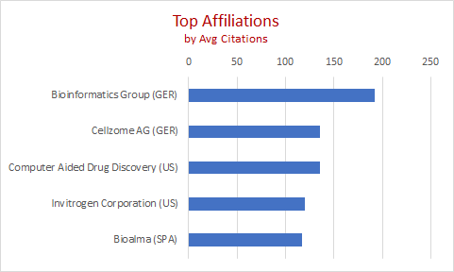
Top 5 Affiliations (highest average citations)

Slide 10
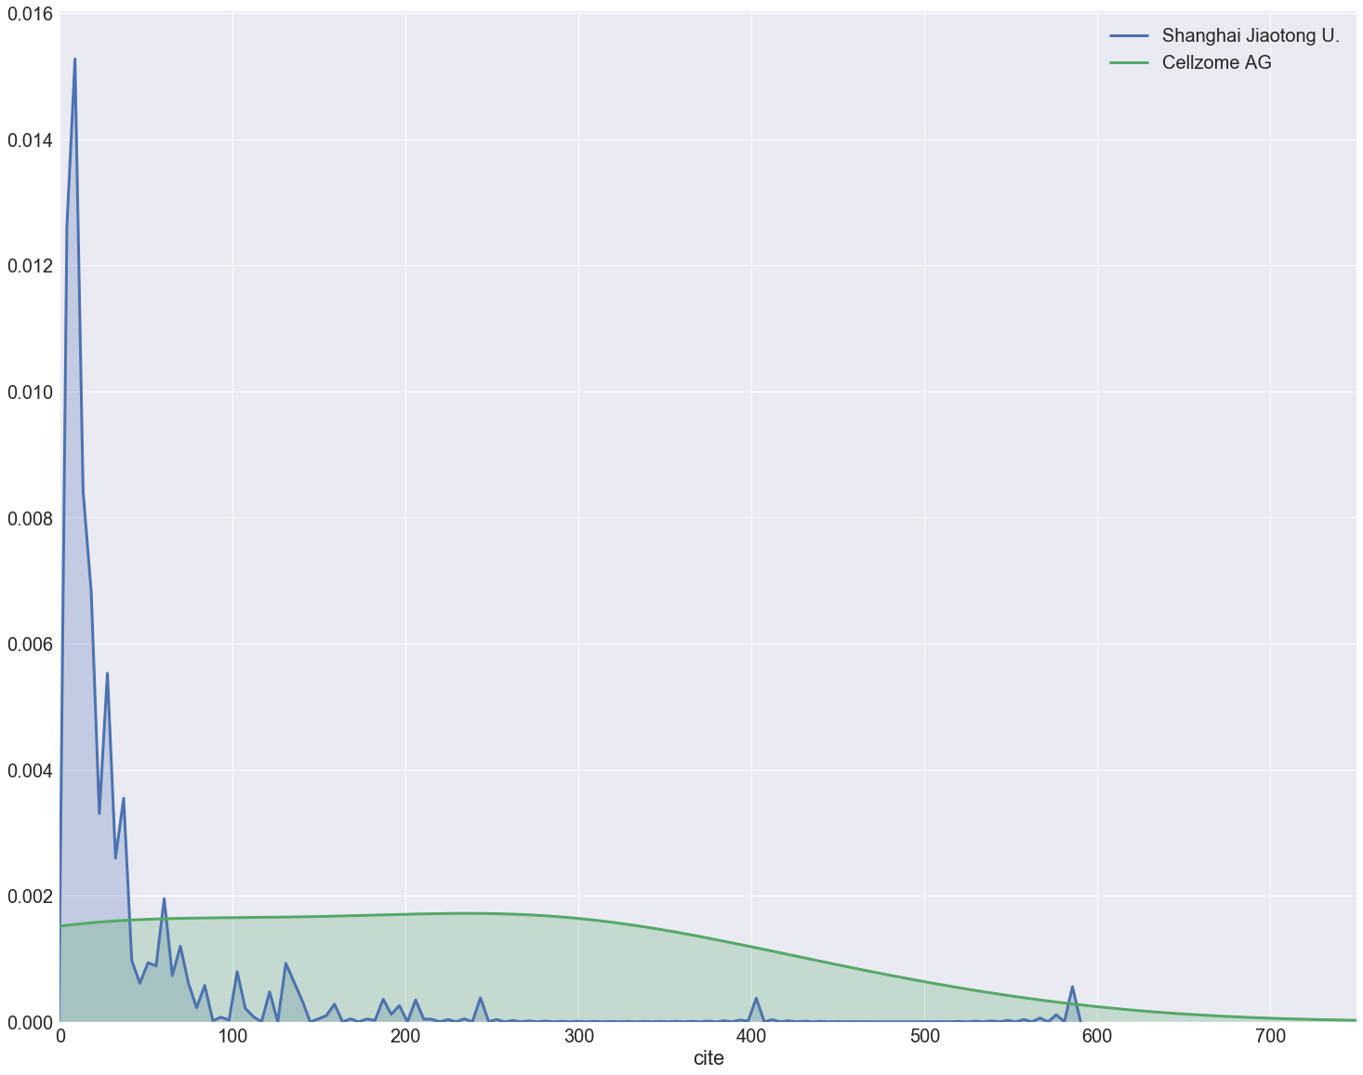
Probability Density Function for Top Two Affiliations

Slide 11
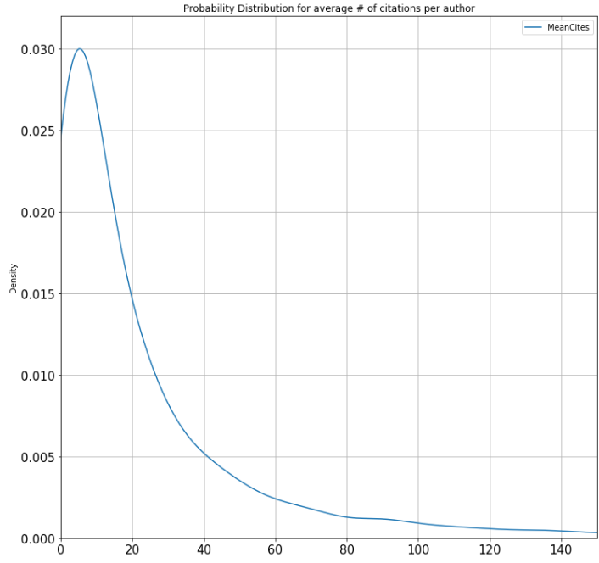
Average Citations Per Author
Probability distribution for average
# of citations per author
> Removed citation outliers greater <
than 3 s.d. from mean
> Removed authors with less than 5 papers <
Average Citations Per Author
s.d. | 41.36
mean | 25.92
median | 11.17
‹#›

Slide 12
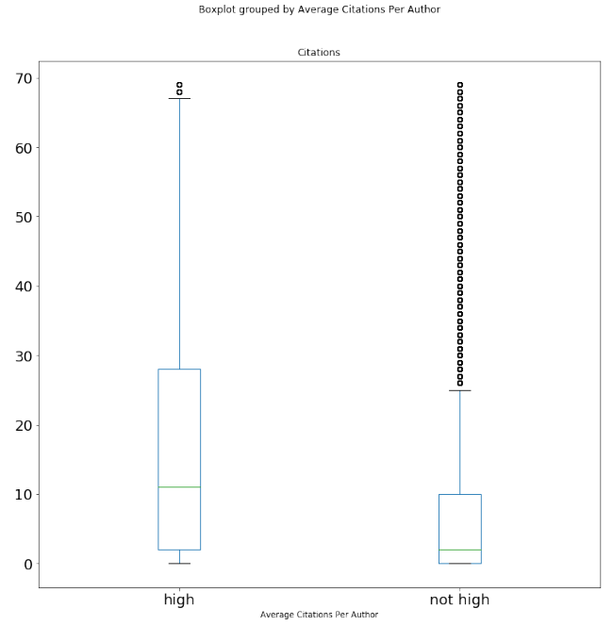
Low vs. High Average
Citations per Author
Boxplots of “High Average
Citations” vs “Low Average Citations”
> Removed citation outliers greater <
than 70 citations
> Removed authors with less than 5 papers <
for the “High’ category
> “High” >= 1 s.d. from the mean <
of the average citations per author
‹#›
Notes:
finish this...

Slide 13
Average Citations Per Author
Top 5 Authors
 | Author Name | Mean Citations | Affiliations
1 | Christie K.R. | 305.75 | Stanford University, USA Stanford University School of Medicine, USA Jackson Laboratory, USA
2 | Hammond M. | 304.17 | European Bioinformatics Institute, UK Wellcome Trust, UK
3 | Morgat A. | 304.11 | Swiss Institute of Bioinformatics, Switzerland INRIA Rhone-Alpes, France, European Bioinformatics Institute, UK Universite de Geneve Faculte de Medecine, Switzerland Ecole Polytechnique Federale de Lausanne, Switzerland
4 | Barrett T. | 302.63 | National Library of Medicine, USA
5 | Barrell D.G. | 300.86 | Mississippi State University, USA European Bioinformatics Institute, UK European Molecular Biology Laboratory, UK Wellcome Trust Sanger Institute, UK
‹#›

Slide 14
Author Keywords Analysis
Find top 10 keywords based on their frequency of occurrence
Find top 10 keywords based on average number of
citations
Compare

Slide 15
Top Keywords based on Frequency of Occurrence
Author_Keyword | Count | Avg_cite
Bioinformatics | 8601 | 17.45
Proteomics | 1290 | 23.19
Genomics | 925 | 22.77
Gene expression | 875 | 23.76
Microarray | 853 | 26.17
Data mining | 709 | 9.66
Mass spectrometry | 691 | 33.73
Systems biology | 574 | 15.35
Computational biology | 517 | 22.73
MicroRNA | 478 | 18.51

Slide 16
Top Keywords based on Average of Citations
Author_Keyword | Counts | Avg_cite
Support vector machines | 132 | 52.17
Neural networks | 127 | 40.72
Inflammation | 129 | 37.36
Functional genomics | 200 | 35.14
Mass spectrometry | 691 | 33.73
Metastasis | 120 | 33.08
Polymorphism | 119 | 31.67
Metabolomics | 273 | 29.92
Arabidopsis thaliana | 102 | 29.70
Clustering | 413 | 28.45

Slide 17
Comparison
High Frequency | Highest Average Citations
Bioinformatics | Support vector machines
Proteomics | Neural networks
Genomics | Inflammation
Gene expression | Functional genomics
Microarray | Mass spectrometry
Data mining | Metastasis
Mass spectrometry | Polymorphism
Systems biology | Metabolomics
Computational biology | Arabidopsis thaliana
MicroRNA | Clustering

Slide 18
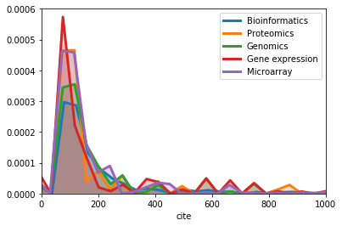
PDF (top 5 high frequency keywords)

Slide 19
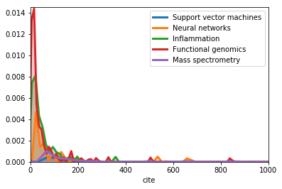
PDF (top 5 high average citation keywords)

Slide 20
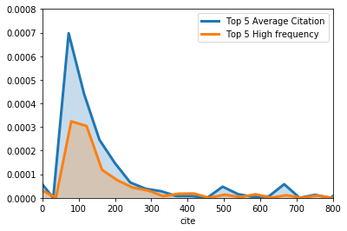
Comparison

Slide 21
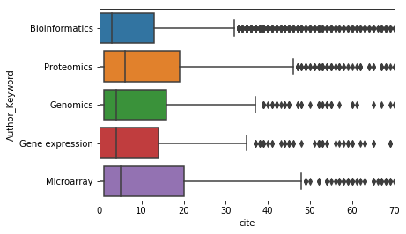
Box Plot (top 5 high frequency keywords)

Slide 22
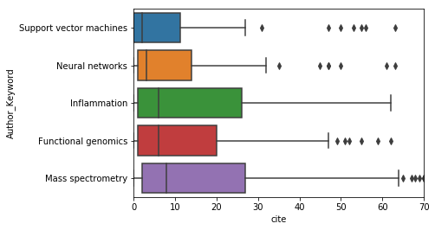
Box Plot (top 5 high average citation keywords)

Slide 23
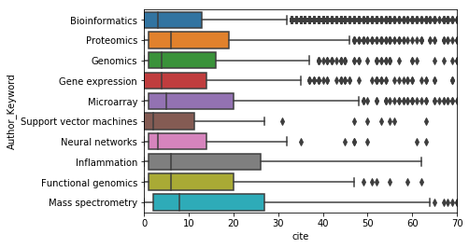
Box Plot Comparison

Slide 24
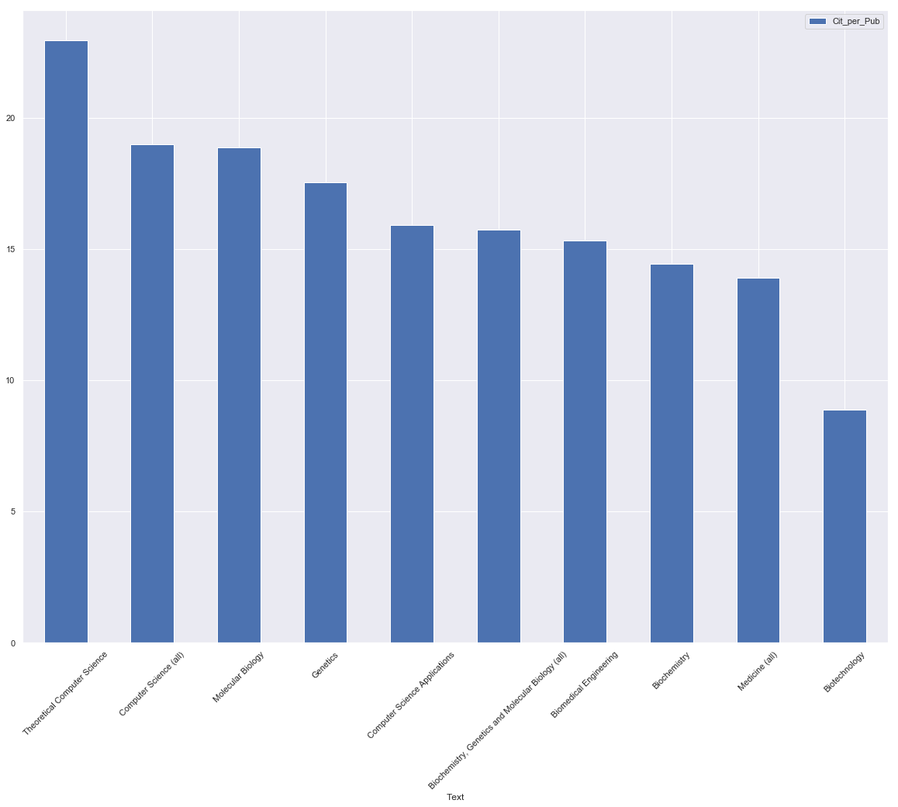
How does the field of study affect the number of citations?
Based on subject areas with most publications

Slide 25
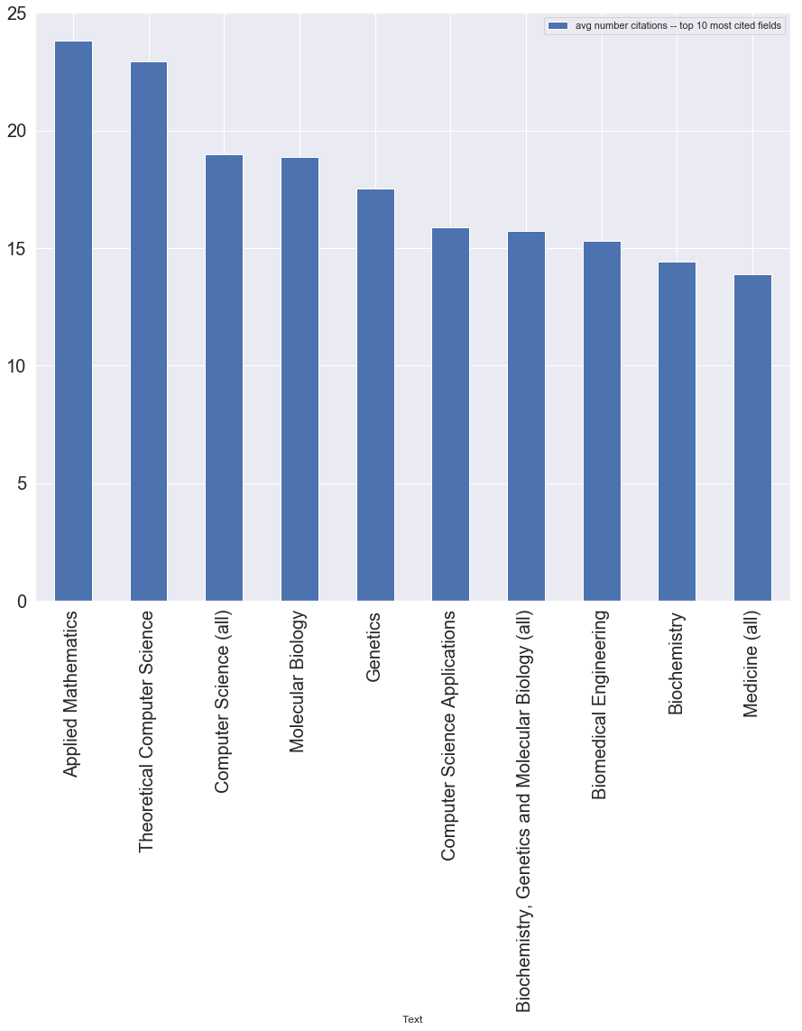
How does the field of study affect the number of citations?
Based on subject areas with most citations

Slide 26
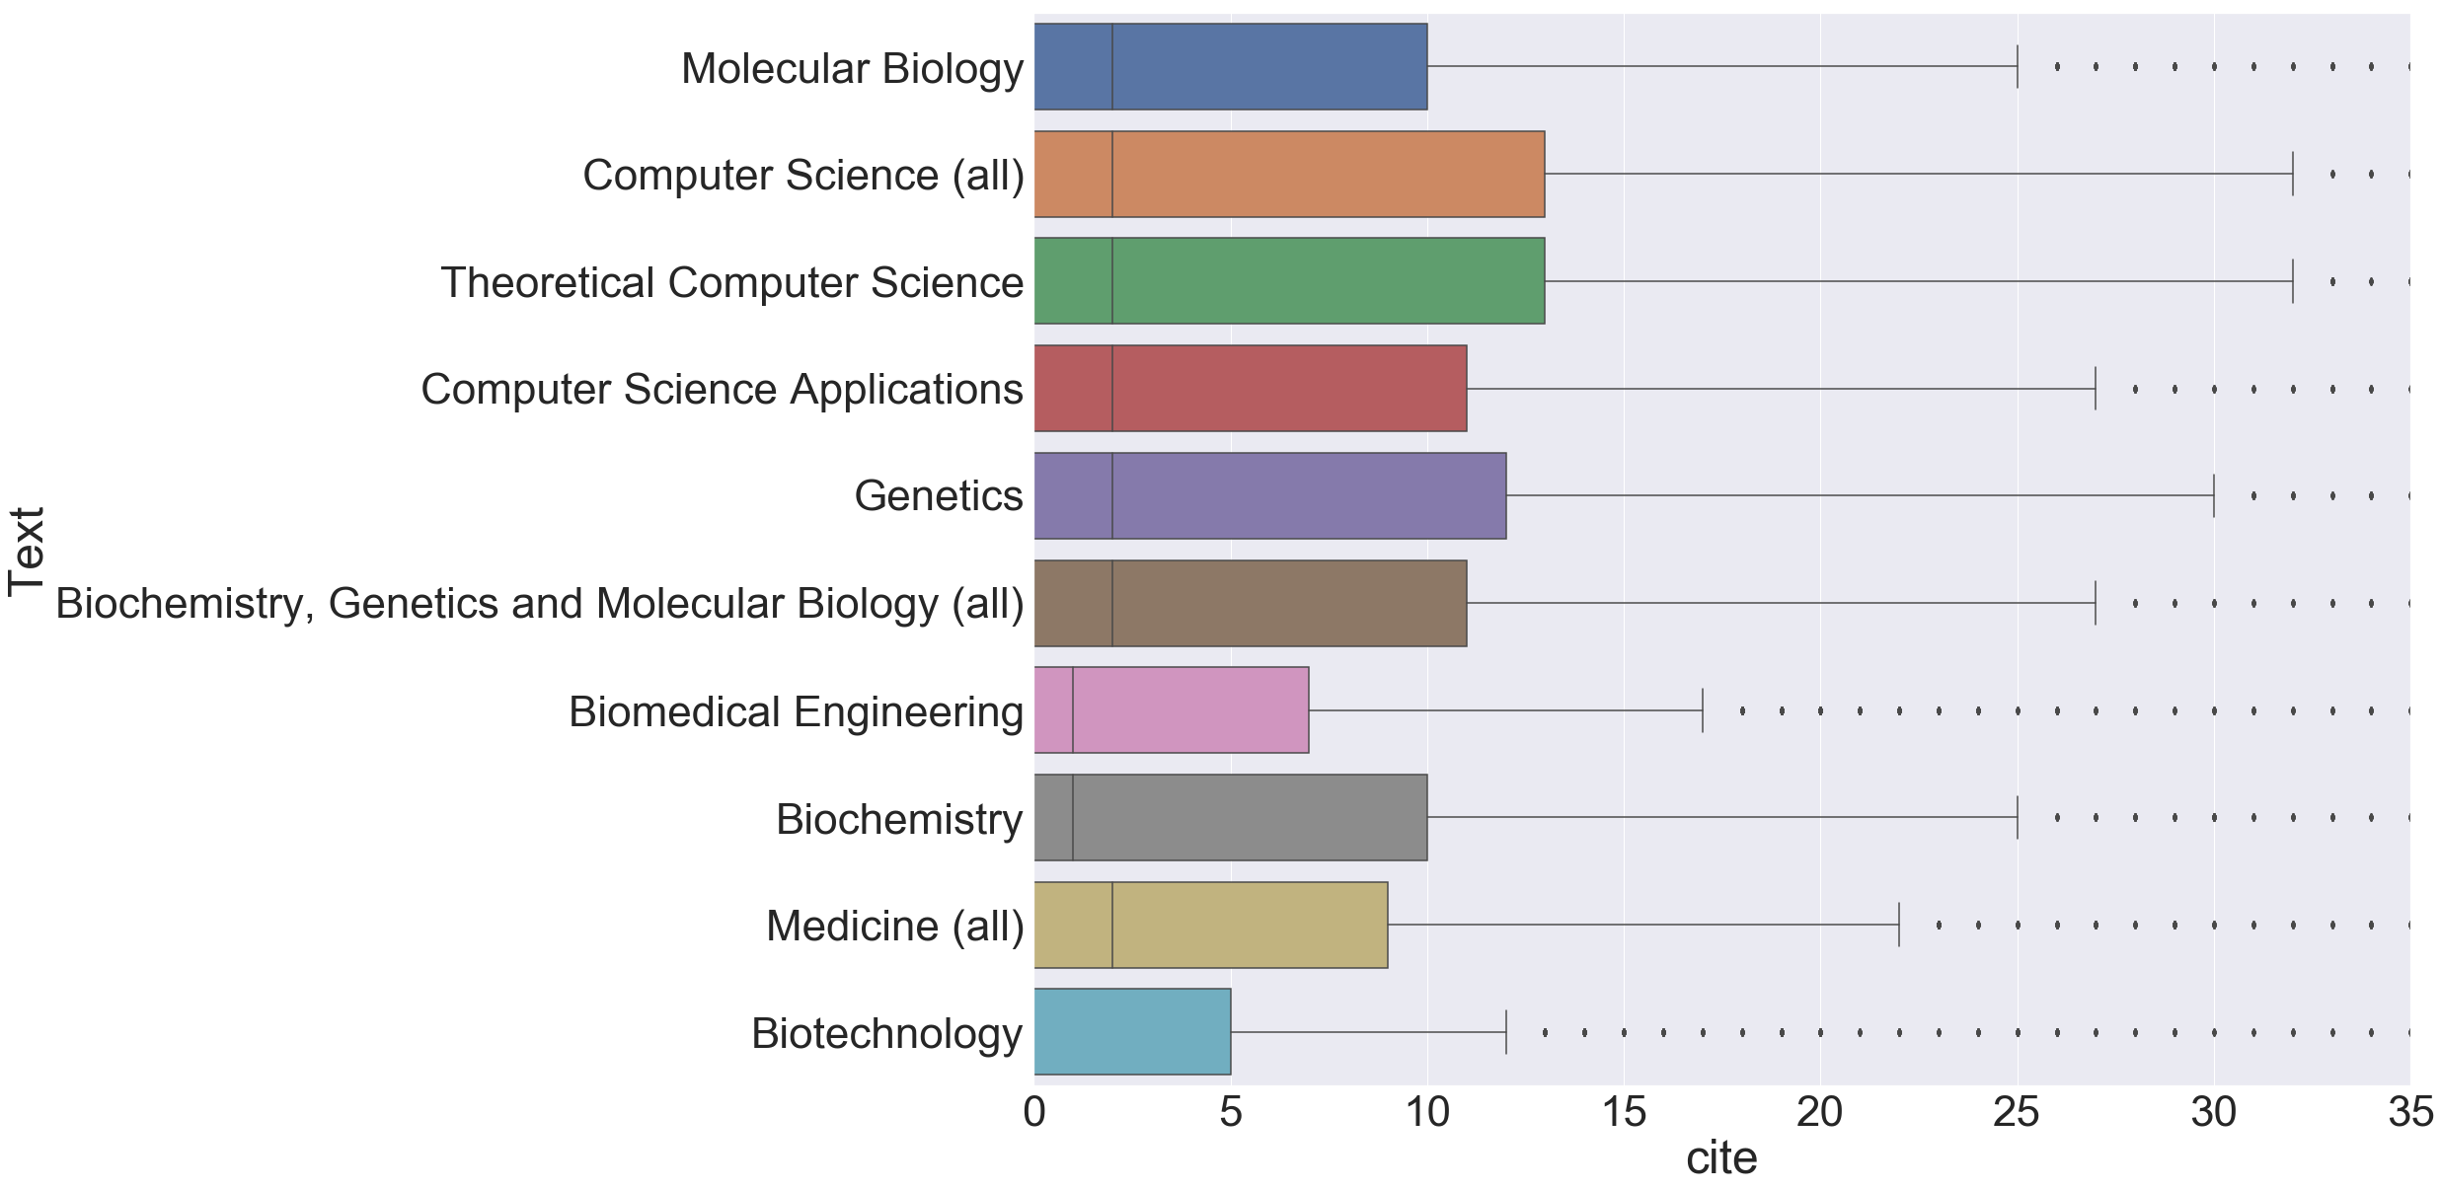
Top 10 Fields (Most Published)

Slide 27
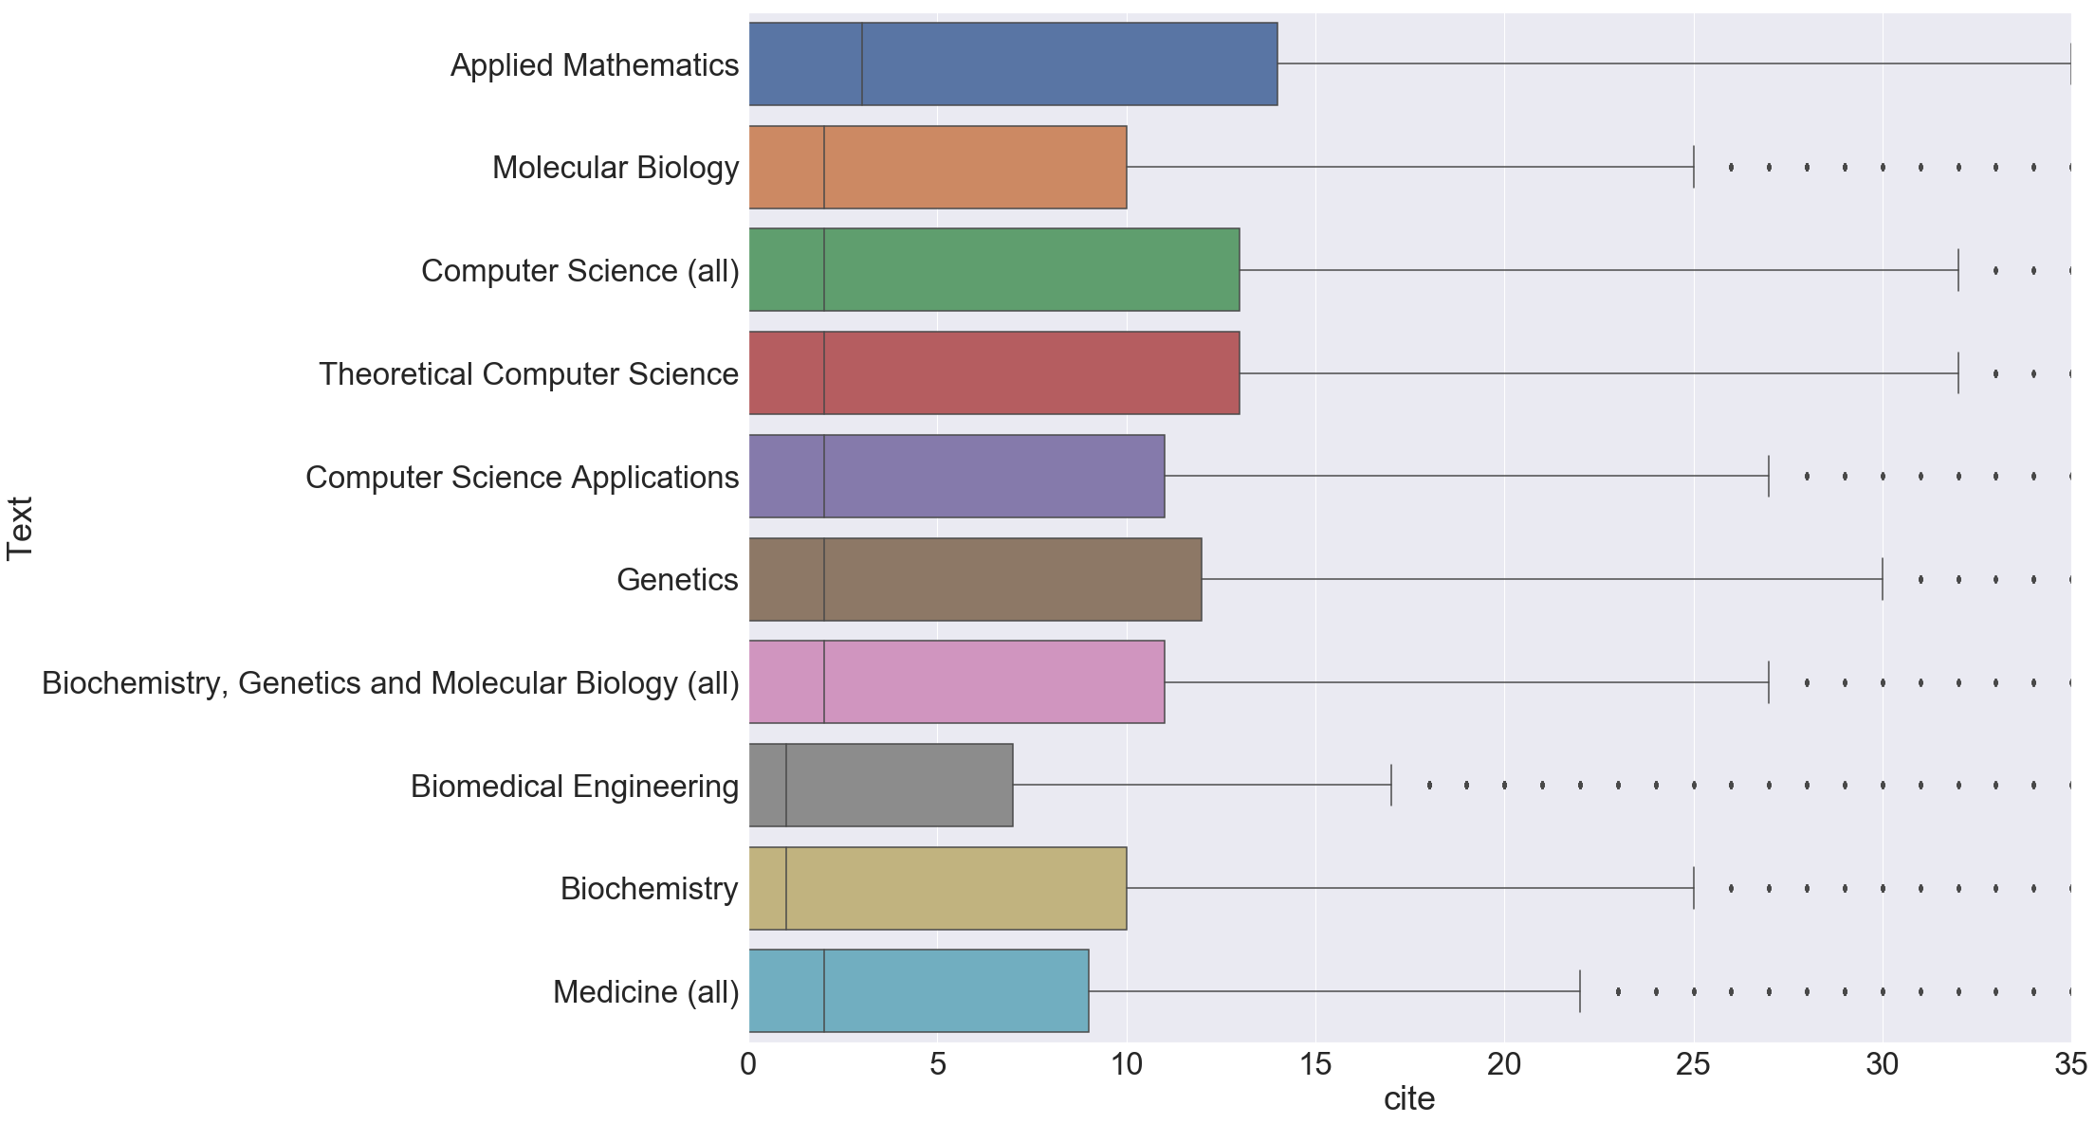
Top 10 Fields (Most Cited)

Slide 28
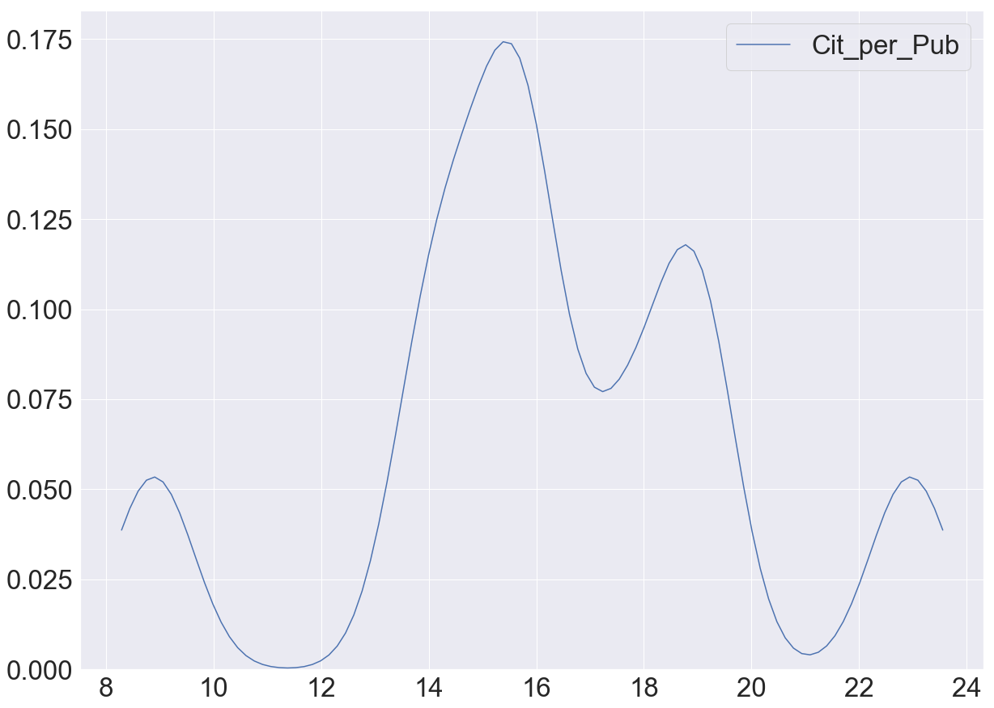
Probability Distribution
Top 10 Fields (Most Cited)

Slide 29
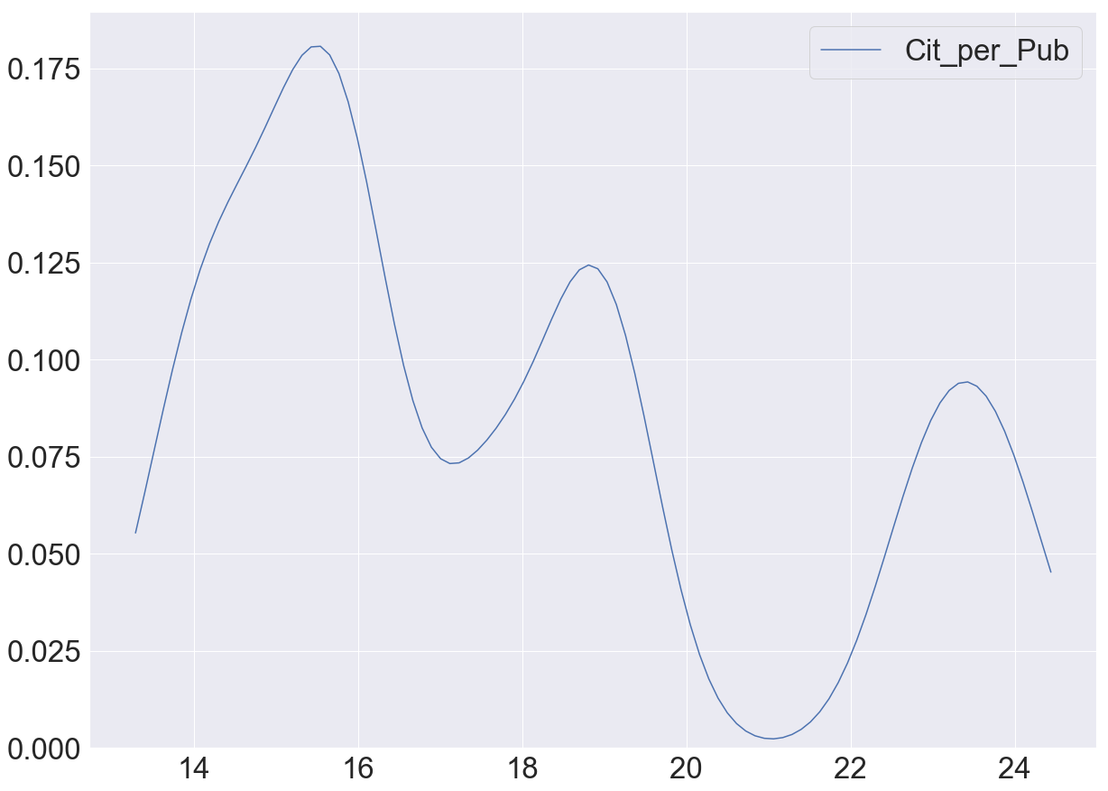
Probability Distribution
Top 10 Fields (Most Cited)

Slide 30
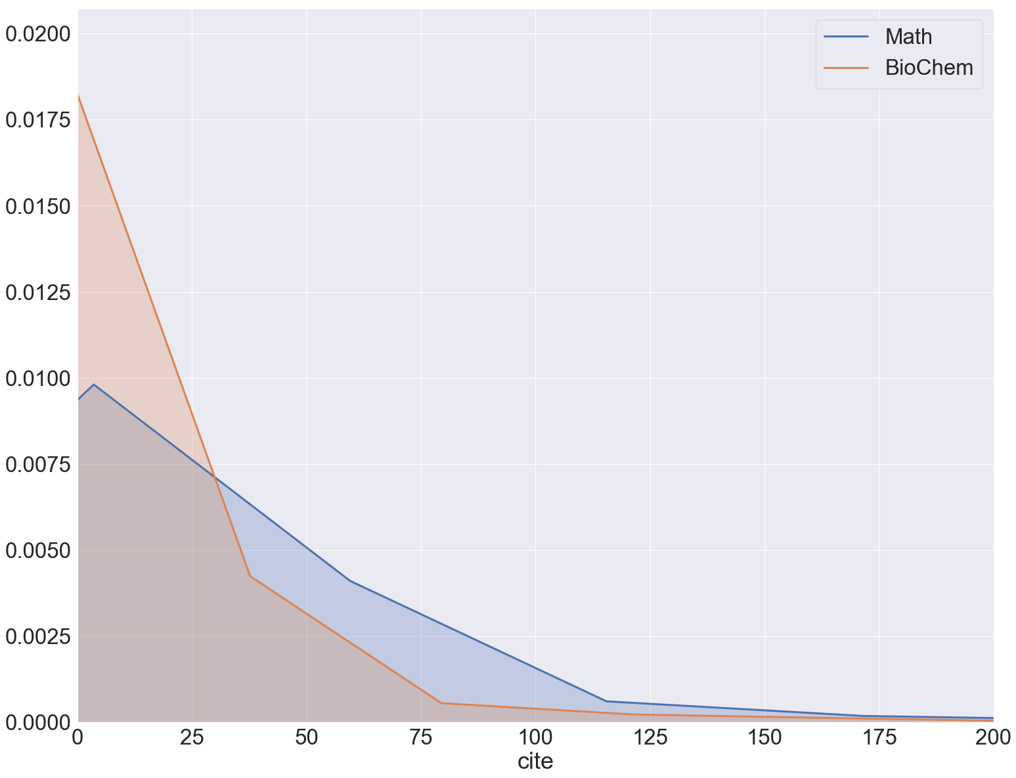
Comparing Probability Distributions
applied mathematics has the most citations/paper
only subject not to appear in both graphs
not enough number of publications.

Slide 31
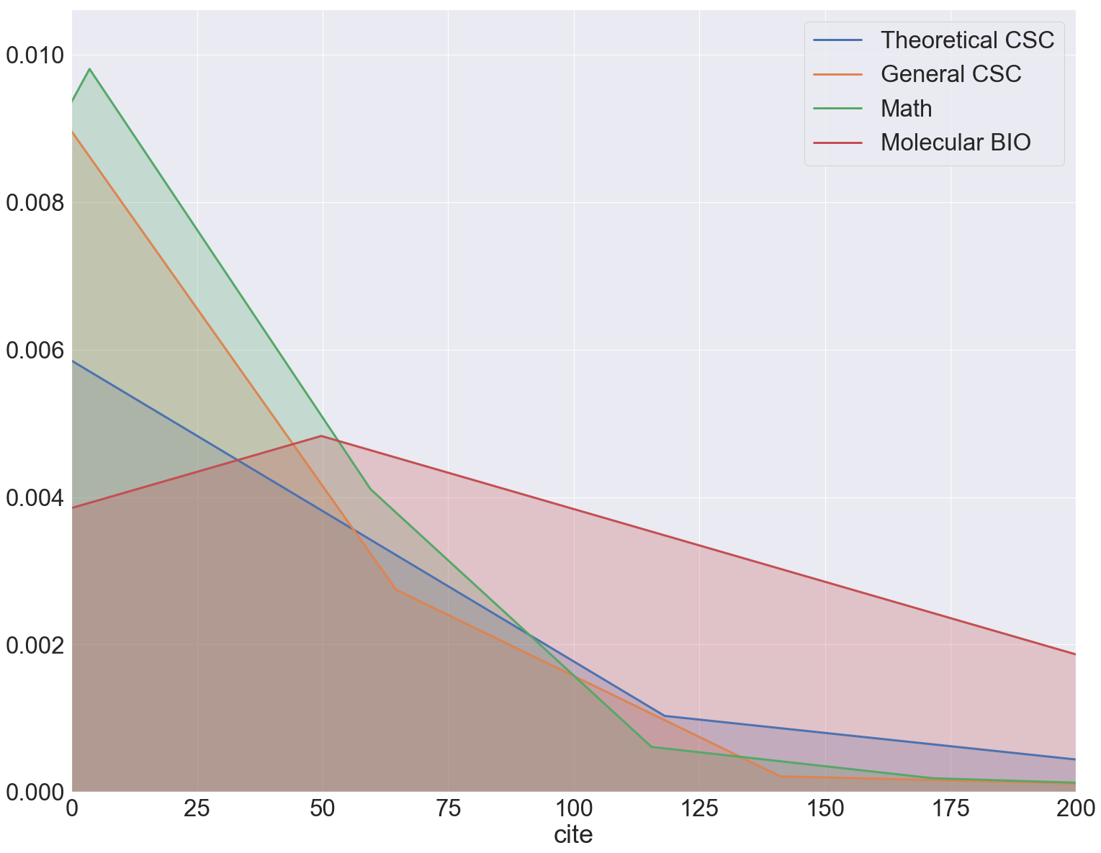
Comparing Probability Distributions
comparing the top 2 subjects from both graphs

Slide 32
Publication venue and citation metrics
 | Publication Name | Number of papers published | Total Citations
1 | Bioinformatics | 2230 | 129777
2 | BMC Bioinformatics | 2039 | 57517
3 | 2010 4th International Conference on Bioinformatics | 2018 | 69
4 | PLoS ONE | 1917 | 28660
5 | 3rd International Conference on Bioinformatics | 1632 | 33
Top 5 publication venues with highest number of publications
‹#›

Slide 33
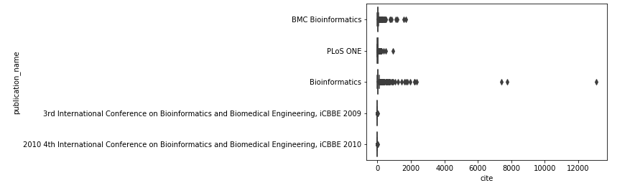
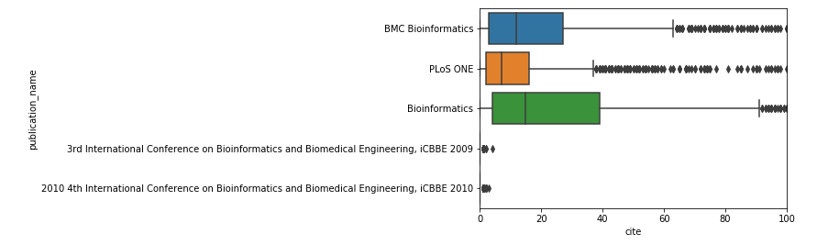

Slide 34
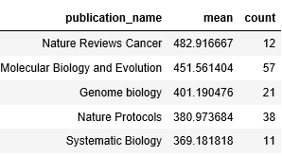
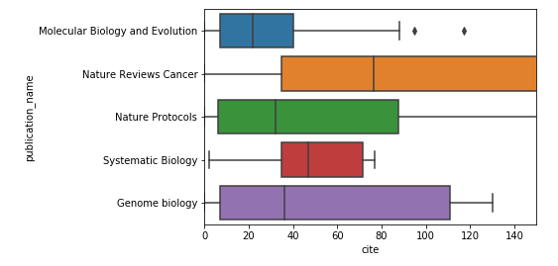
Top 5 publication venues with highest mean citations(minimum number of papers published if 10).
‹#›

Slide 35
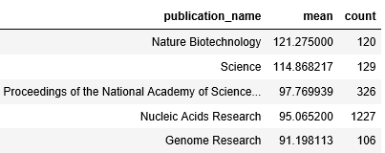
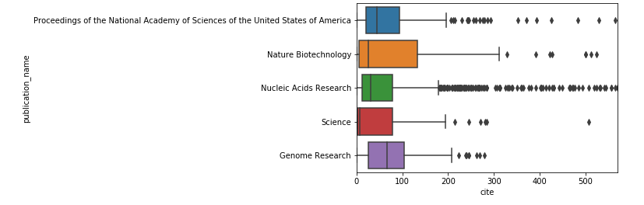
Top 5 publication venues with highest mean citations(minimum number of papers published if 100).

Slide 36
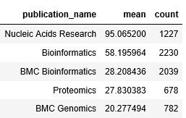
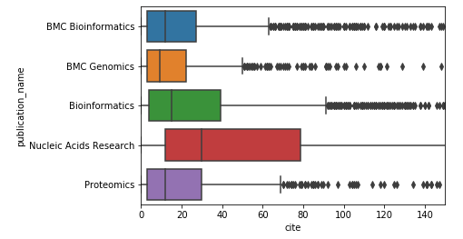
Top 5 publication venues with highest mean citations(minimum number of papers published if 500).

Slide 37
Top 5 fields of study based on publication venue
Theoretical Computer Science
Biomedical Engineering
Computer Science (all)
Genetics
Molecular Biology

